Slide 1
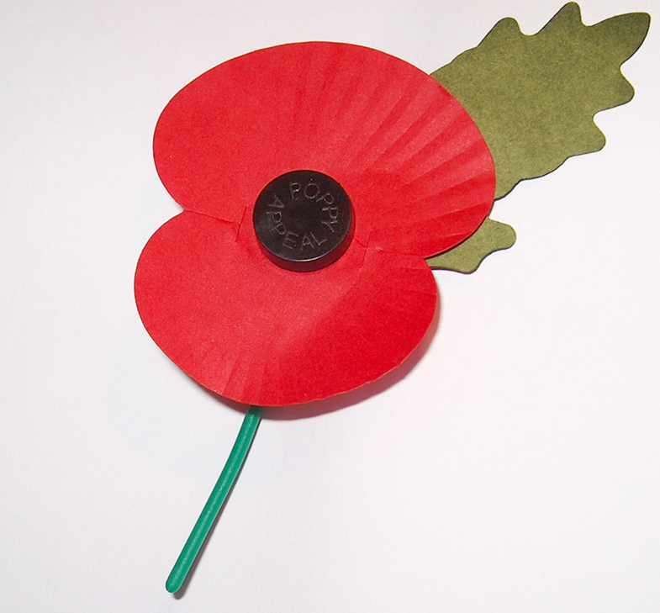
Think, pair and share
Why do many people choose to wear this on or in the build up to 11th November each year?

Slide 2
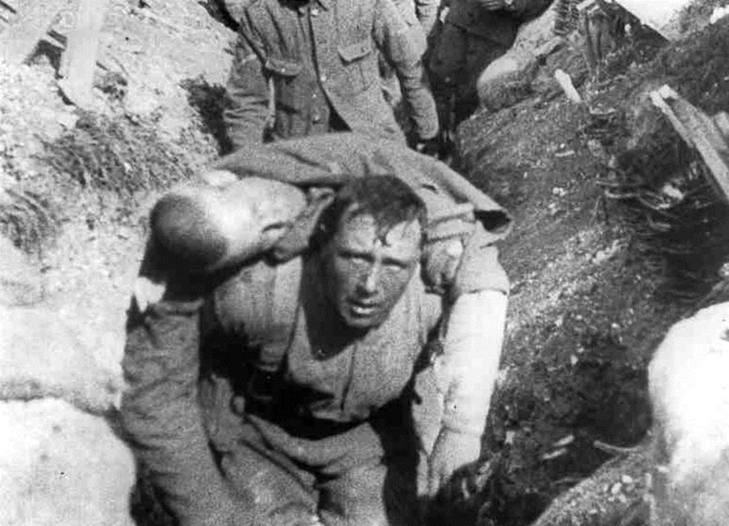
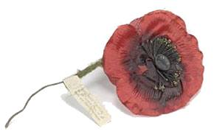
A brief history of the poppy
On the eleventh hour of the eleventh day of the eleventh month in 1918, the First World War ended.
Civilians wanted to remember the people who had given their lives for peace and freedom.
An American War Secretary, Moina Michael, inspired by the Canandian doctor John McCrae's poem,"In Flanders' Fields", began selling poppies to friends to raise money for the ex-Service community.

Slide 3
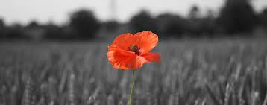
Video clip – 2 minutes
https://www.youtube.com/watch?v=pAWfiTM2KsA&feature=youtu.be&safe=active

Slide 4
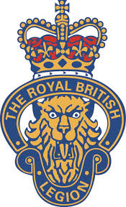
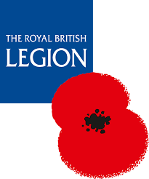
Think, pair and share
Who are the Royal British Legion and what do they do?

Slide 5
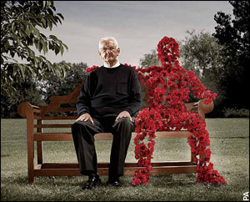
The Royal British Legion
The Royal British Legion are the UK's leading Service charity.
They provide practical care, advice and support to serving members of the Armed Forces, veterans of all ages and their families.

Slide 6
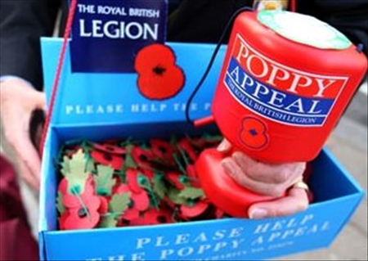
Wear your poppy with pride
Each year the nation expresses its unequivocal support for The Royal British Legion's work through the Poppy Appeal.
More than 40 million remembrance poppies are made at the Poppy Factory each year.

Slide 7
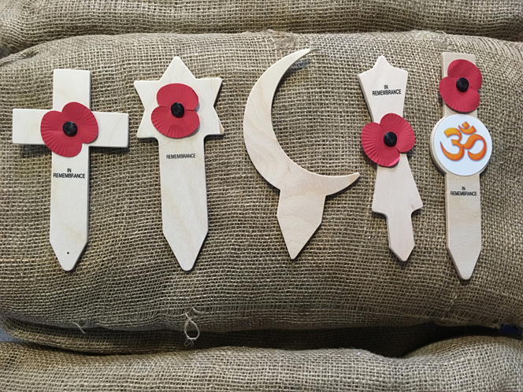
It is important to understand that the red poppy produced by the Royal British Legion poppy is a symbol of remembrance to commemorate soldiers (from all faiths and none) who have died in war in the service of their country.
Sikhism
Christianity
Judaism
Hinduism
What faiths are represented here?
Islam

Slide 8
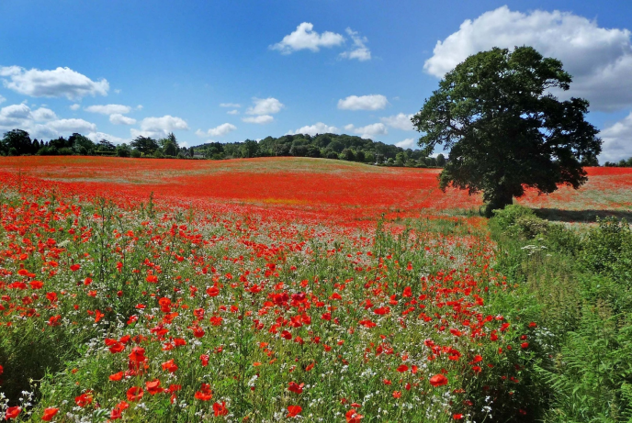
The poppy is:
A symbol of Remembrance and hope
Worn by millions of people
Red because of the natural colour of field poppies
The poppy is not:
A symbol of death or a sign of support for war
A reflection of politics or religion
Red to reflect the colour of blood

Slide 9
Think, pair and share
What do you think is the message of this piece of artwork?

Slide 10
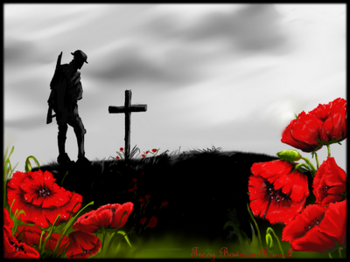
Wear your poppy with pride

